Slide 1
How to Cope with Holiday Stress and Depression
Ruth Scheufler LPCC-S, LICDC
Aultman Medical Foundation

Slide 2
Stress
Stress is the body’s normal reaction to any change that requires an adjustment or response.
Distress
Eustress
Physical, mental, and emotional responses.
Fight or flight response

Slide 3
Acute vs. Chronic Stress
Acute Stress:
Short periods of time
Identifiable trigger
44% of women and 31% of men report an increase in stress around the holidays.
Chronic Stress:
Longer duration of time
Multiple triggers, often overlap
Physical response is engaged
Impacts your health, mood, productivity, relationships, and quality of life.
American Psychological Association (APA)

Slide 4
The Holiday Blues vs. Clinical Depression

Slide 5
“It’s the most wonderful time of the year, with kids jingle belling, and everyone telling you “be of good cheer”…. It’s the most wonderful time of the year!”

Slide 6
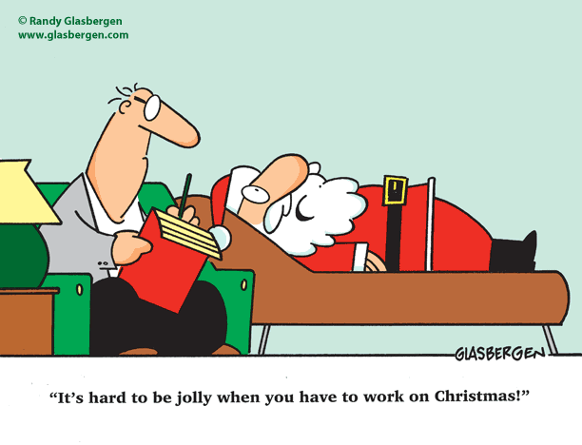
Holiday Stress Culprits
Finances
Commercialization of the holidays
Changes in the economy
Changes in employment
Physical Demands
Travel
Changes in routine
Changes in nutrition
Unrealistic Expectations
Shoulds
Compare and despair
End of year expectations
Grief
Physical distance from loved ones
Death of a loved one
Loss related to unrealized goals for this year

Slide 7
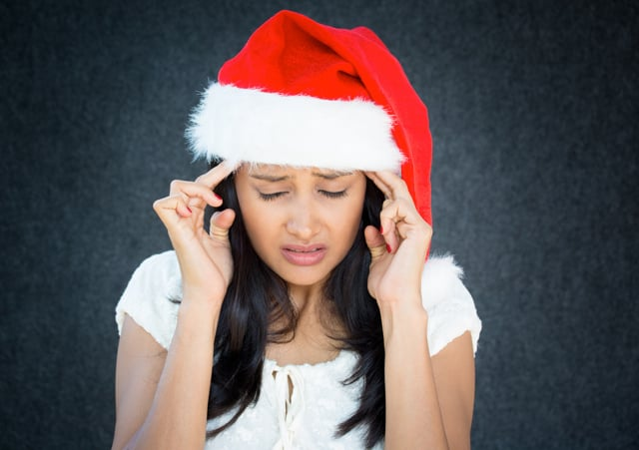
Signs of the Holiday Blues
Dizziness or feeling “out of it”
General physical aches and pains
Grinding your teeth
Headaches
Changes in appetite
Increased muscle tension in neck, face or shoulders
Changes in sleep
Increased fatigue
Significant changes in weight
Upset stomach
Increased irritability
Social withdrawal
Lower motivation

Slide 8
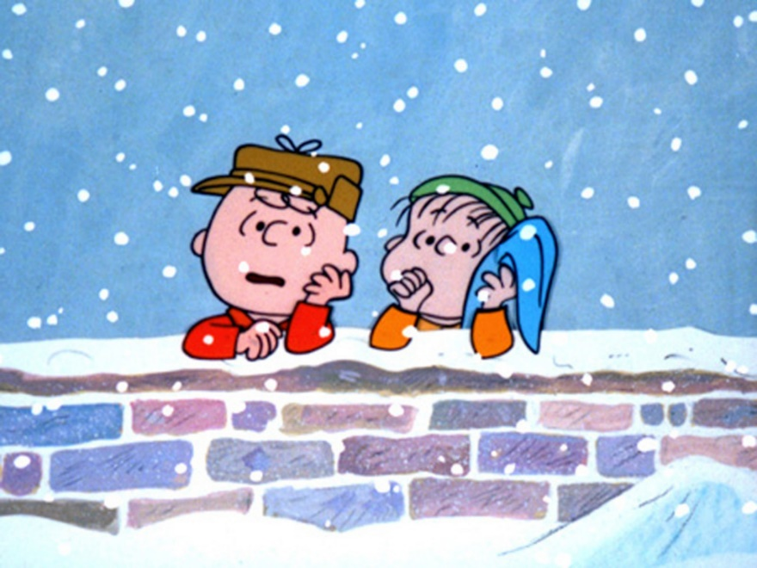
Helping Myself
Financial
Budget
Make one decision at a time.
Track spending.
Avoid impulsive spending.
Be creative.
Grief
Reach out to others.
Honor those I have lost.
Know that it is normal to feel sadness.
Avoid unstructured time.
Notice gratitude.
Get professional help, if needed.
Physical Demands
Plan ahead.
Say “no”.
Prioritize sleep.
Maintain routine (☺).
Use relaxation skills.
Go outside.
Unrealistic Expectations
No celebration is “perfect”.
Maintain social connection.
Know my values.
Be patient with myself.
Volunteer

Slide 9
Seasonal Affective Disorder (SAD)
3 of 4 people impacted by SAD are women
Increased risk between the ages of 15 and 30
Begins between September / October and subsides in April / May.
Biological vs. Environmental
Melatonin levels are higher
Sleep
Serotonin levels are lower
Natural mood stabilizer
People who live further from the equator
Vitamin D levels are lower
Individuals who already struggle with depression or bipolar disorder may see an increase in symptoms during this time.

Slide 10
Helpful Interventions for SAD
Phototherapy
Support
Light box (25x brighter than normal lighting)
30 minutes per day
Side Effects:
Irritability
Headaches
Increase social interaction
Counseling
Cognitive Behavioral Therapy
Lifestyle Adjustments
Medication
A 30-minute walk is as effective as 2 ½ hours of phototherapy
Relaxation / mindfulness
Strengthen routine
Purposeful pleasant activities
Possibly adjust existing medication dose
Short-term use of medication

Slide 11
Major Depressive Disorder ≥ 5 symptoms in the same 2-week period
Major Depressive Episode (SIG E CAPS)
Sleep – hypersomnia or insomnia nearly every day
Interest – subjective account or observation by others of decreased interest
Guilt – worthlessness or excessive/unjustified guilt
Energy – fatigue or loss of energy
Concentration – diminished ability to concentrate, increased indecision
Appetite – significant weight loss or gain, changes in appetite
Psychomotor – agitation or retardation, often observable by others
Suicidality – recurrent thoughts of death or suicide

Slide 12
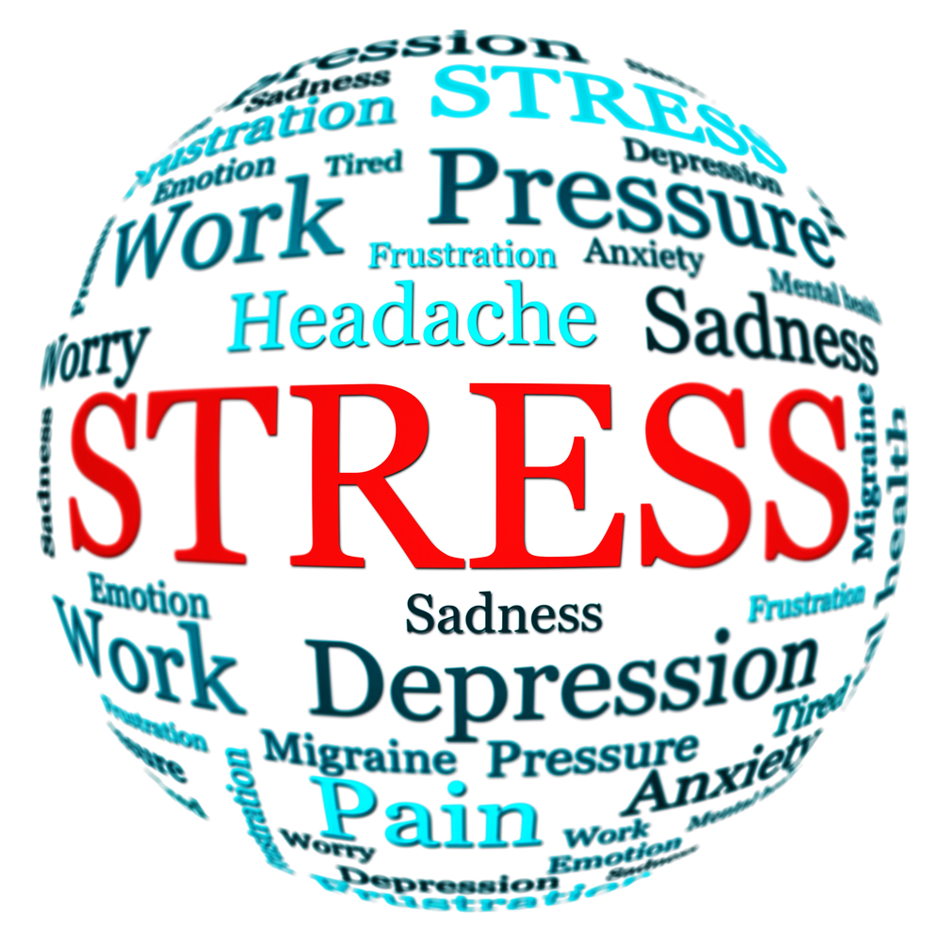
Signs of Depression in Others
Low energy
Self criticism
Unusually pessimistic
Changes in sleep schedule
Changes in appetite or weight
Irritability / Mood swings
Reduced interest in hobbies
Withdrawal from people
Reduced interest in personal hygiene
Increased substance use
Forced happiness
Physical pain
Changes in sex drive

Slide 13
Coming Along Side
Be aware
Be available
Be patient
Be non-judgmental
Be present
Be forgiving

Slide 14
Crisis Contact Information
988 – New national suicide hotline
Domestic Violence Help Line: 330-453-SAFE (7233)
LGBTQ Crisis Hotline: 1-866-4-U-TREVOR (866-488-7386)
National Suicide Prevention Lifeline: 988
National Crisis Text Line: Text “4hope” to 741741
Stark County Crisis Hotline: 330-452-6000
Veterans’ Crisis Hotline: 988, press 1

Slide 15
THANK YOU
Ruth Scheufler LPCC-S, LICDC
ruth.scheufler@aultman.com
(330)363-4929

