Slide 1
Fire Prevention
Identifying Common Hazards
Notes:
I'd like to switch gears for just a moment and talk about one of the most disastrous forms of loss plaguing our businesses across the country right now. Fires!

Slide 2
Fire Losses- Frequency
Federated Fire Losses - FREQUENCY
Notes:
When we look at fire claims , we noticed that frequency is up considerably over the last three years. In fact, the 244 separate fire claims Federated saw last year represents a significant increase over what we have seen historically. While Federated insures more buildings today, than we did in 2018 and 2019, the growth in fires has significantly outpaced our growth in accounts.

Slide 3
Fire Losses- Average Severity
Federated Fire Losses - AVG
Notes:
Our average fire claim in 2022 was $490,000, which is up significantly over historic norms. In fact, it’s about double what we saw from 2018 – 2020. We are writing larger accounts that have larger buildings. But, here again, it doesn’t explain the entire increase we have seen.

Slide 4
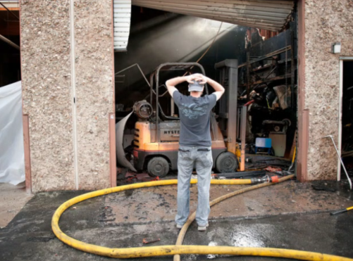
Understanding The Exposure
Every business is susceptible to loss by fire
According to (FEMA) 40 percent of companies do not reopen after a disaster
Another 25 percent fail within one year
Notes:
It's important to understand that every business with a property is susceptible to fire loss

Slide 5
Why are these fires occurring?
Repurposed/Renovated Buildings
Delayed preventative maintenance on machinery & equipment
Common Hazards
Notes:
So let’s go a step deeper. In simple terms a “nuclear verdict” is a jury award of $10 million or greater. However, this definition is good in conversation but too simplistic in practice. I think there are two classifications of a nuclear verdict – one is numerical (a $10 million or greater jury award or settlement) and one is based on the outcome relative to expectations (e.g. if “x” is the expectation but the jury award is 5-10 times x).
A key distinguishing factor of a nuclear verdict is that it is disproportionate in terms of having little to no direct relation to a plaintiff’s actual economic damages, meaning the majority of the award is due to punitive and non-economic damages. Therefore, one good way to summarize a nuclear verdict is an award that is significantly higher than would be expected given the injuries in the case.
Look at this sampling of 2019 nuclear verdicts – no settlements are included. This is not an exhaustive list, and none involved Federated policyholders. These are all commercial auto verdicts. What else do they have in common? Good, innocent people killed or maimed on the roads, due to little or no fault of their own, combined with aggravating circumstances that caused a jury to not only compensate, but punish. Whether it’s poor driver training, distracted driving, or a seemingly unremorseful defendant, the juries in these cases were looking for revenge.
The highlighted verdict was a remote jury’s decision in 2020 after a remote Zoom trial – the largest ever against a single trucking company defendant

Slide 6
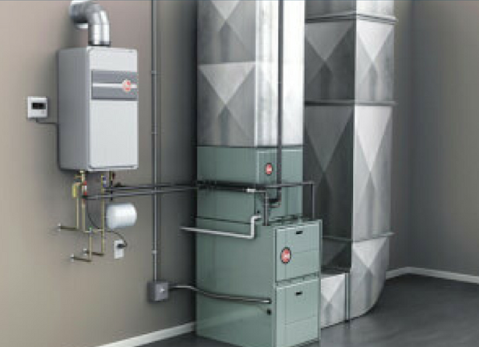
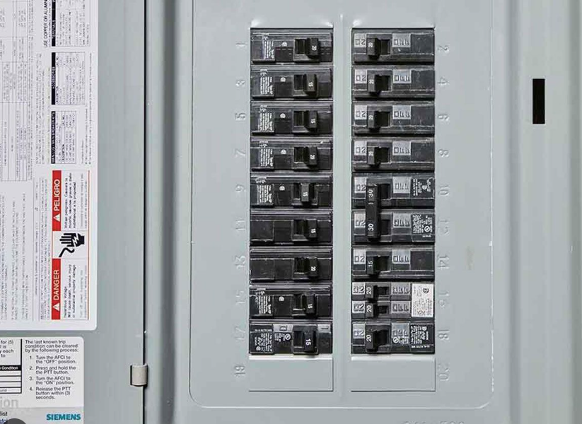
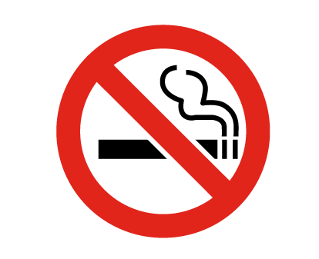
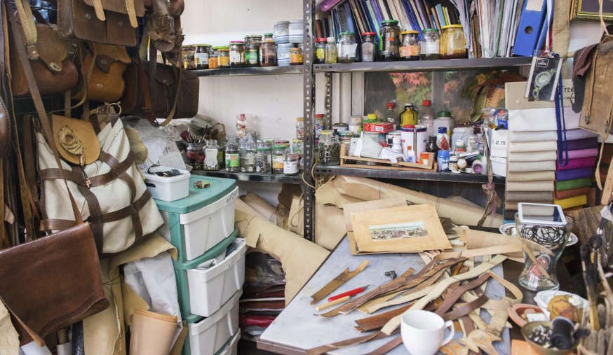
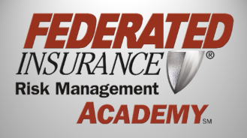
Common Hazards
Heating
Electrical
Smoking
Housekeeping
Notes:
Now let's talk about the four main hazards that are present in almost all businesses.

Slide 7
Types of Hazards
Common Hazards
(Seen in almost every business)
Special Hazards
(Type of business specific)
Heating
Electrical
Smoking
Housekeeping
Greasy or Oily Rags
Lithium-ion powered tools/equipment
Notes:
Special hazards pertain to the specific nature of the operation that the business performs. These might include operations such as:
Welding
Grinding
Spray Finishing
Or Cooking
For this presentation we are going to focus on the four common hazards that will most likely lead to a fire in your business if left unchecked.
However, there two types of special hazards that we need to address before we move on as they are quickly become some of the most common causes of fire related losses.
Greasy or Oily Rags and Lithium-ion battery powered tools/equipment.

Slide 8
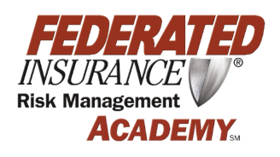
Rag cans deprive a fire of adequate oxygen
Oil-soaked combustible rags are subject to ignition by other sources such as welding sparks, cutting torch slag, a carelessly dropped match or cigarette.
Rag cans also provide a safe place to store your hazardous rags
Rag cans
Notes:
Although the video addresses stain rags; Oil soaked combustible rags are subject to ignition by other sources such as welding sparks, cutting torch slag, a carelessly dropped match or cigarette.
Simply said an oily rag can deprives a fire of one of it’s key components (oxygen).
The bottom of the can is also specially engineered to reduce heat to the floor preventing pyrolysis to the floor.

Slide 9
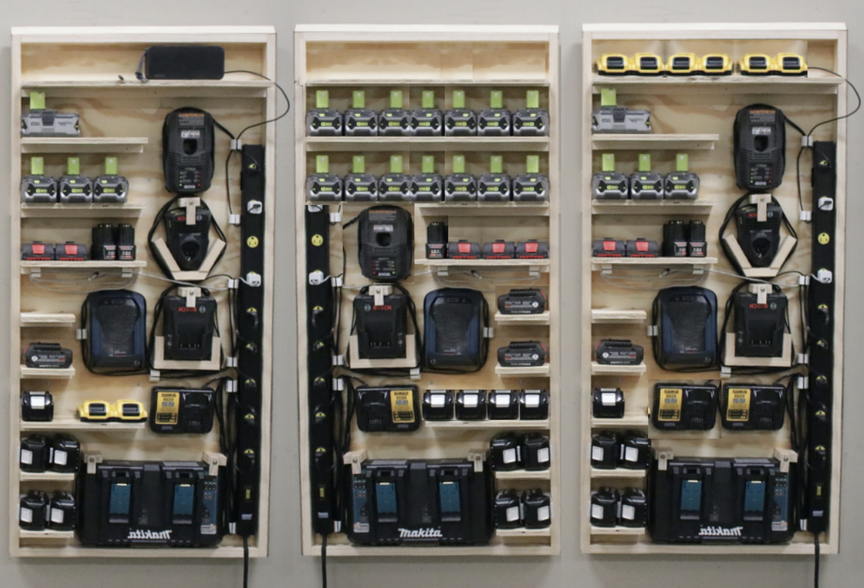
Lithium-ion Batteries
Notes:
Another more recent cause of fires has been lithium ion batteries
Batteries with defects or damage can fail, resulting in fires or even explosions.
Heat released from a failed cell in a lithium ion battery can cause a chain reaction called “thermal runaway”, where heat is produced faster than it can be dispersed.
Thermal runaway can be very difficult to stop once it has started.

Slide 10
The Solution
Store batteries and devices in a dry, cool place
Before use, inspect batteries and devices for damage
Remove lithium-ion powered devices and batteries from chargers once fully charged
Lithium-ion battery chargers should not be left plugged in overnight

Slide 11
What is Pyrolysis?
The chemical decomposition of materials resulting from exposure to heat

Slide 12
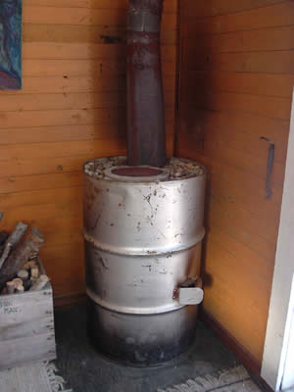
Warning Signs
Notes:
Those aren't shadows on the wall next to the stove pipe.
Note the char. Discoloration is evidence of pyrolysis. Given additional time, ignition likely could have occurred.

Slide 13
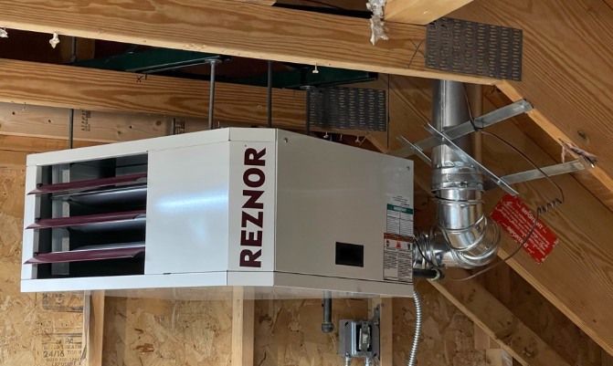
What To Look For
Notes:
Is there anything wrong with the image on the left?
The suspended gas heater on the right is something we frequently see in businesses and it's very common to find combustible inventory stacked in front of these heaters

Slide 14
Electrical
Daisy chaining power strips is against OSHA regulations and can cause overloading which can lead to the power strip to fail and even start on fire
Daisy Chaining

Slide 15
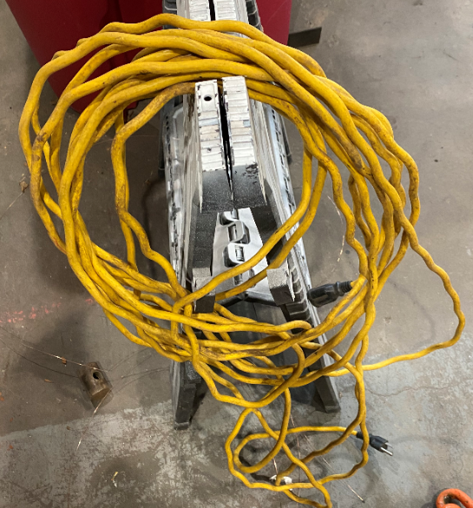
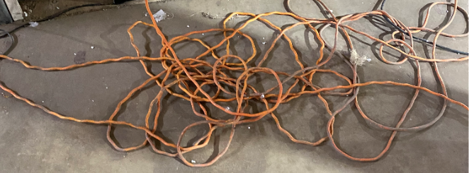
Overheated Extension Cords
Notes:
Do your extension cords appear to be crimping? This is actually a sign of overheating as the protective coating shrinks as a result of the wires overheating inside.

Slide 16
Electrical Panel Boxes/Circuit Breakers
To avoid damage to the interior, blanks should be utilized.
Circuit Breakers should not be utilized as an on/off switch for lights.
Circuit Breakers should generally not exceed 120 degrees & any one breaker should not be more than 20 degrees hotter than other breakers in the system.
Notes:
1. Overcurrent protection 2. Confine arcing/fire to enclosure if there is a loose connection or large surge of current due to a lightning strike.

Slide 17
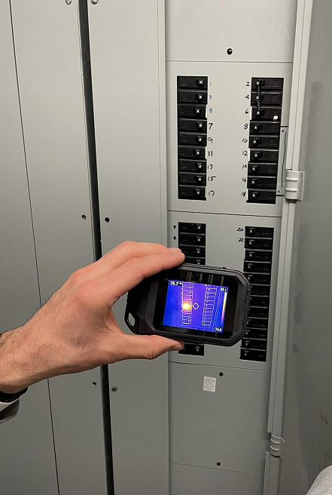
IR Technology
Federated has equipped over 60 of our field Risk Consultants with infrared cameras to be able to identify any potential trouble areas within electrical systems
Notes:
These infrared cameras can be used to detect hotspots in electrical systems that may be cause for further inspection.
More to come in June of 2023.

Slide 18
Electric Space Heaters
Principles for Safe Operation
U.L.-Listed & in good condition
Equipped with automatic tip-over shutoff
Plug directly into an outlet
Position at least 3 feet away from combustibles
Don’t leave unattended while in use
Unplugged at the end of the day

Slide 19
Game Plan
Have a Federated Risk Consultant come to your property & complete a Fire Safety Walkthrough, including Thermography Scan
Discussion on Top 5 Exposures to keep any eye out for on a monthly basis
All employees trained & safety incentive program introduced

Slide 20
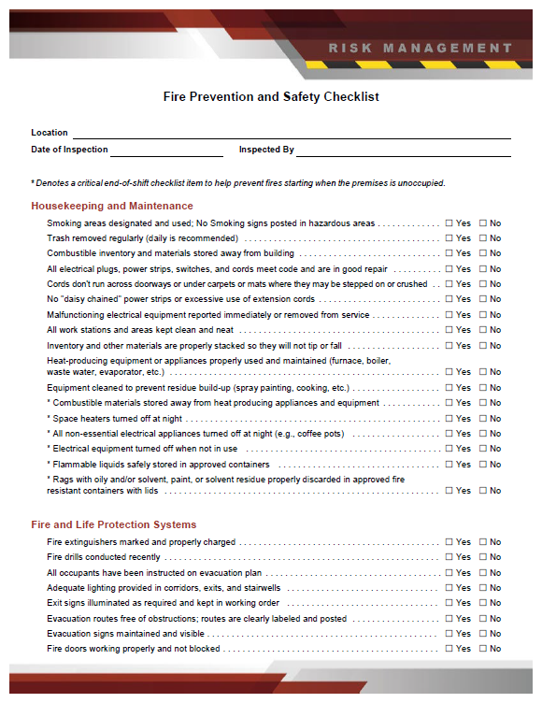
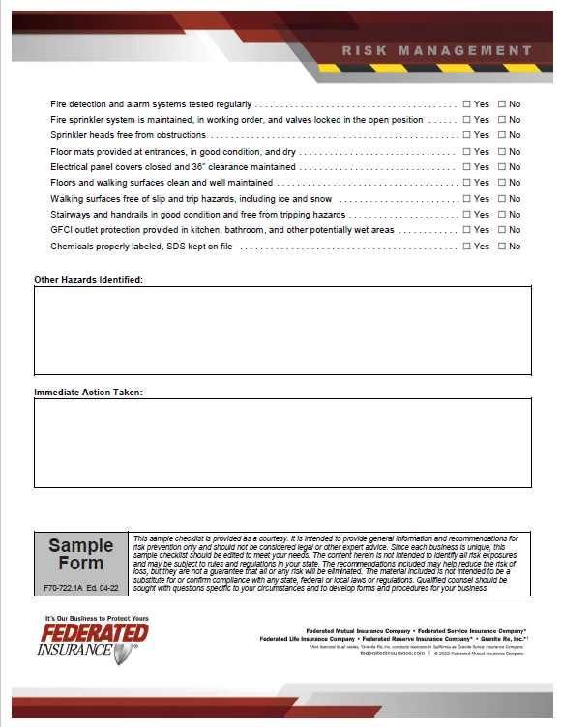
Conduct Your Own Walkthroughs
Fire
Prevention and Safety Checklist
Notes:
Since COVID many businesses have seen a drop in the workforce. Positions that were historically designed or committed to workplace safety and equipment maintenance have been dissolved or conflated with other positions within the company.
Take an honest look at your safety culture and ask yourself “what are we currently doing to proactively identify and resolve fire hazards throughout our facility?”
I challenge you to conduct monthly or at least quarterly walkthroughs of your facility looking for fire hazards such as the four common we have listed.
Please consider using this fire prevention and safety checklist as a guide to help you with managing risk at each of your locations.

