Slide 1
Fantasies and Realities of Safety in a Production Driven World
Renée Onesti
Passionate about American Manufacturing

Slide 2
Some
Fantasies about safety

Slide 3
This stuff is HARD!
If it was easy, we wouldn’t need this kind of help.

Slide 4
maintenance
Finance
HR
Safety
Management

Slide 5
Some
Realities about safety

Slide 6
Learning Objectives
Is safety a core value?
Recognize the leadership skills required to grow safety.
Prioritize safety to get the most from your resources at any level.

Slide 7
My journey…

Slide 8
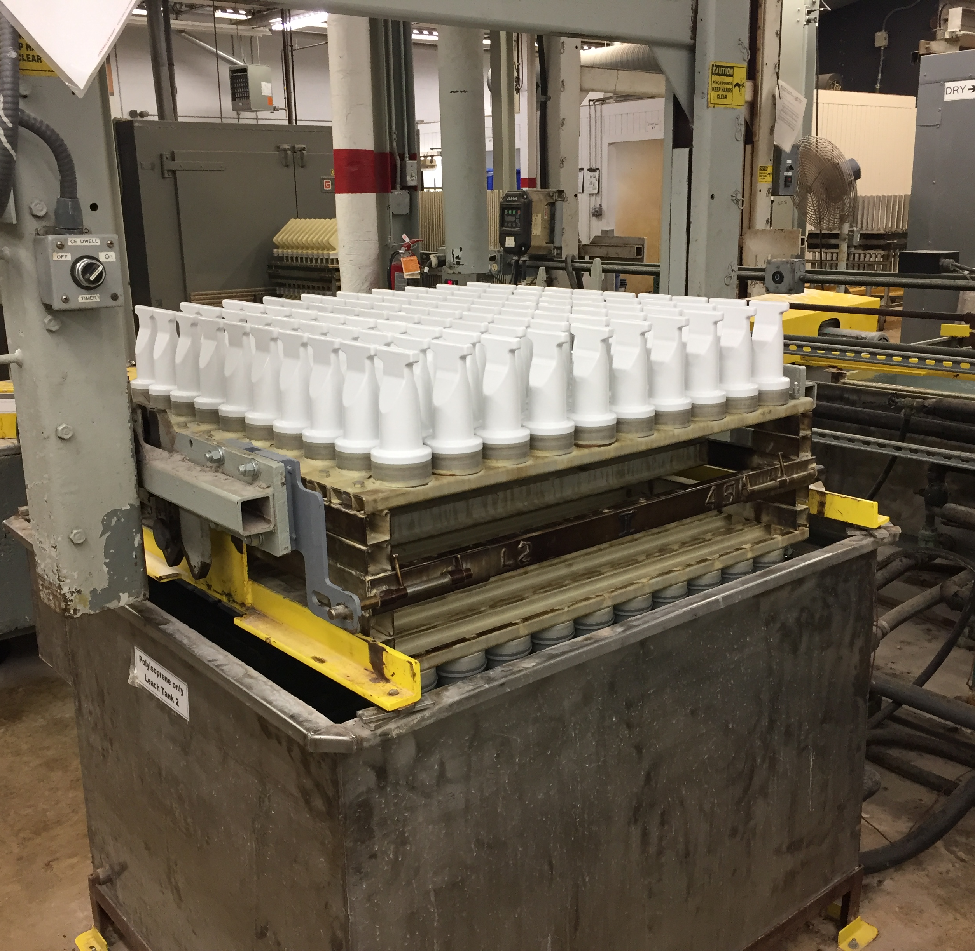
A new adventure

Slide 9
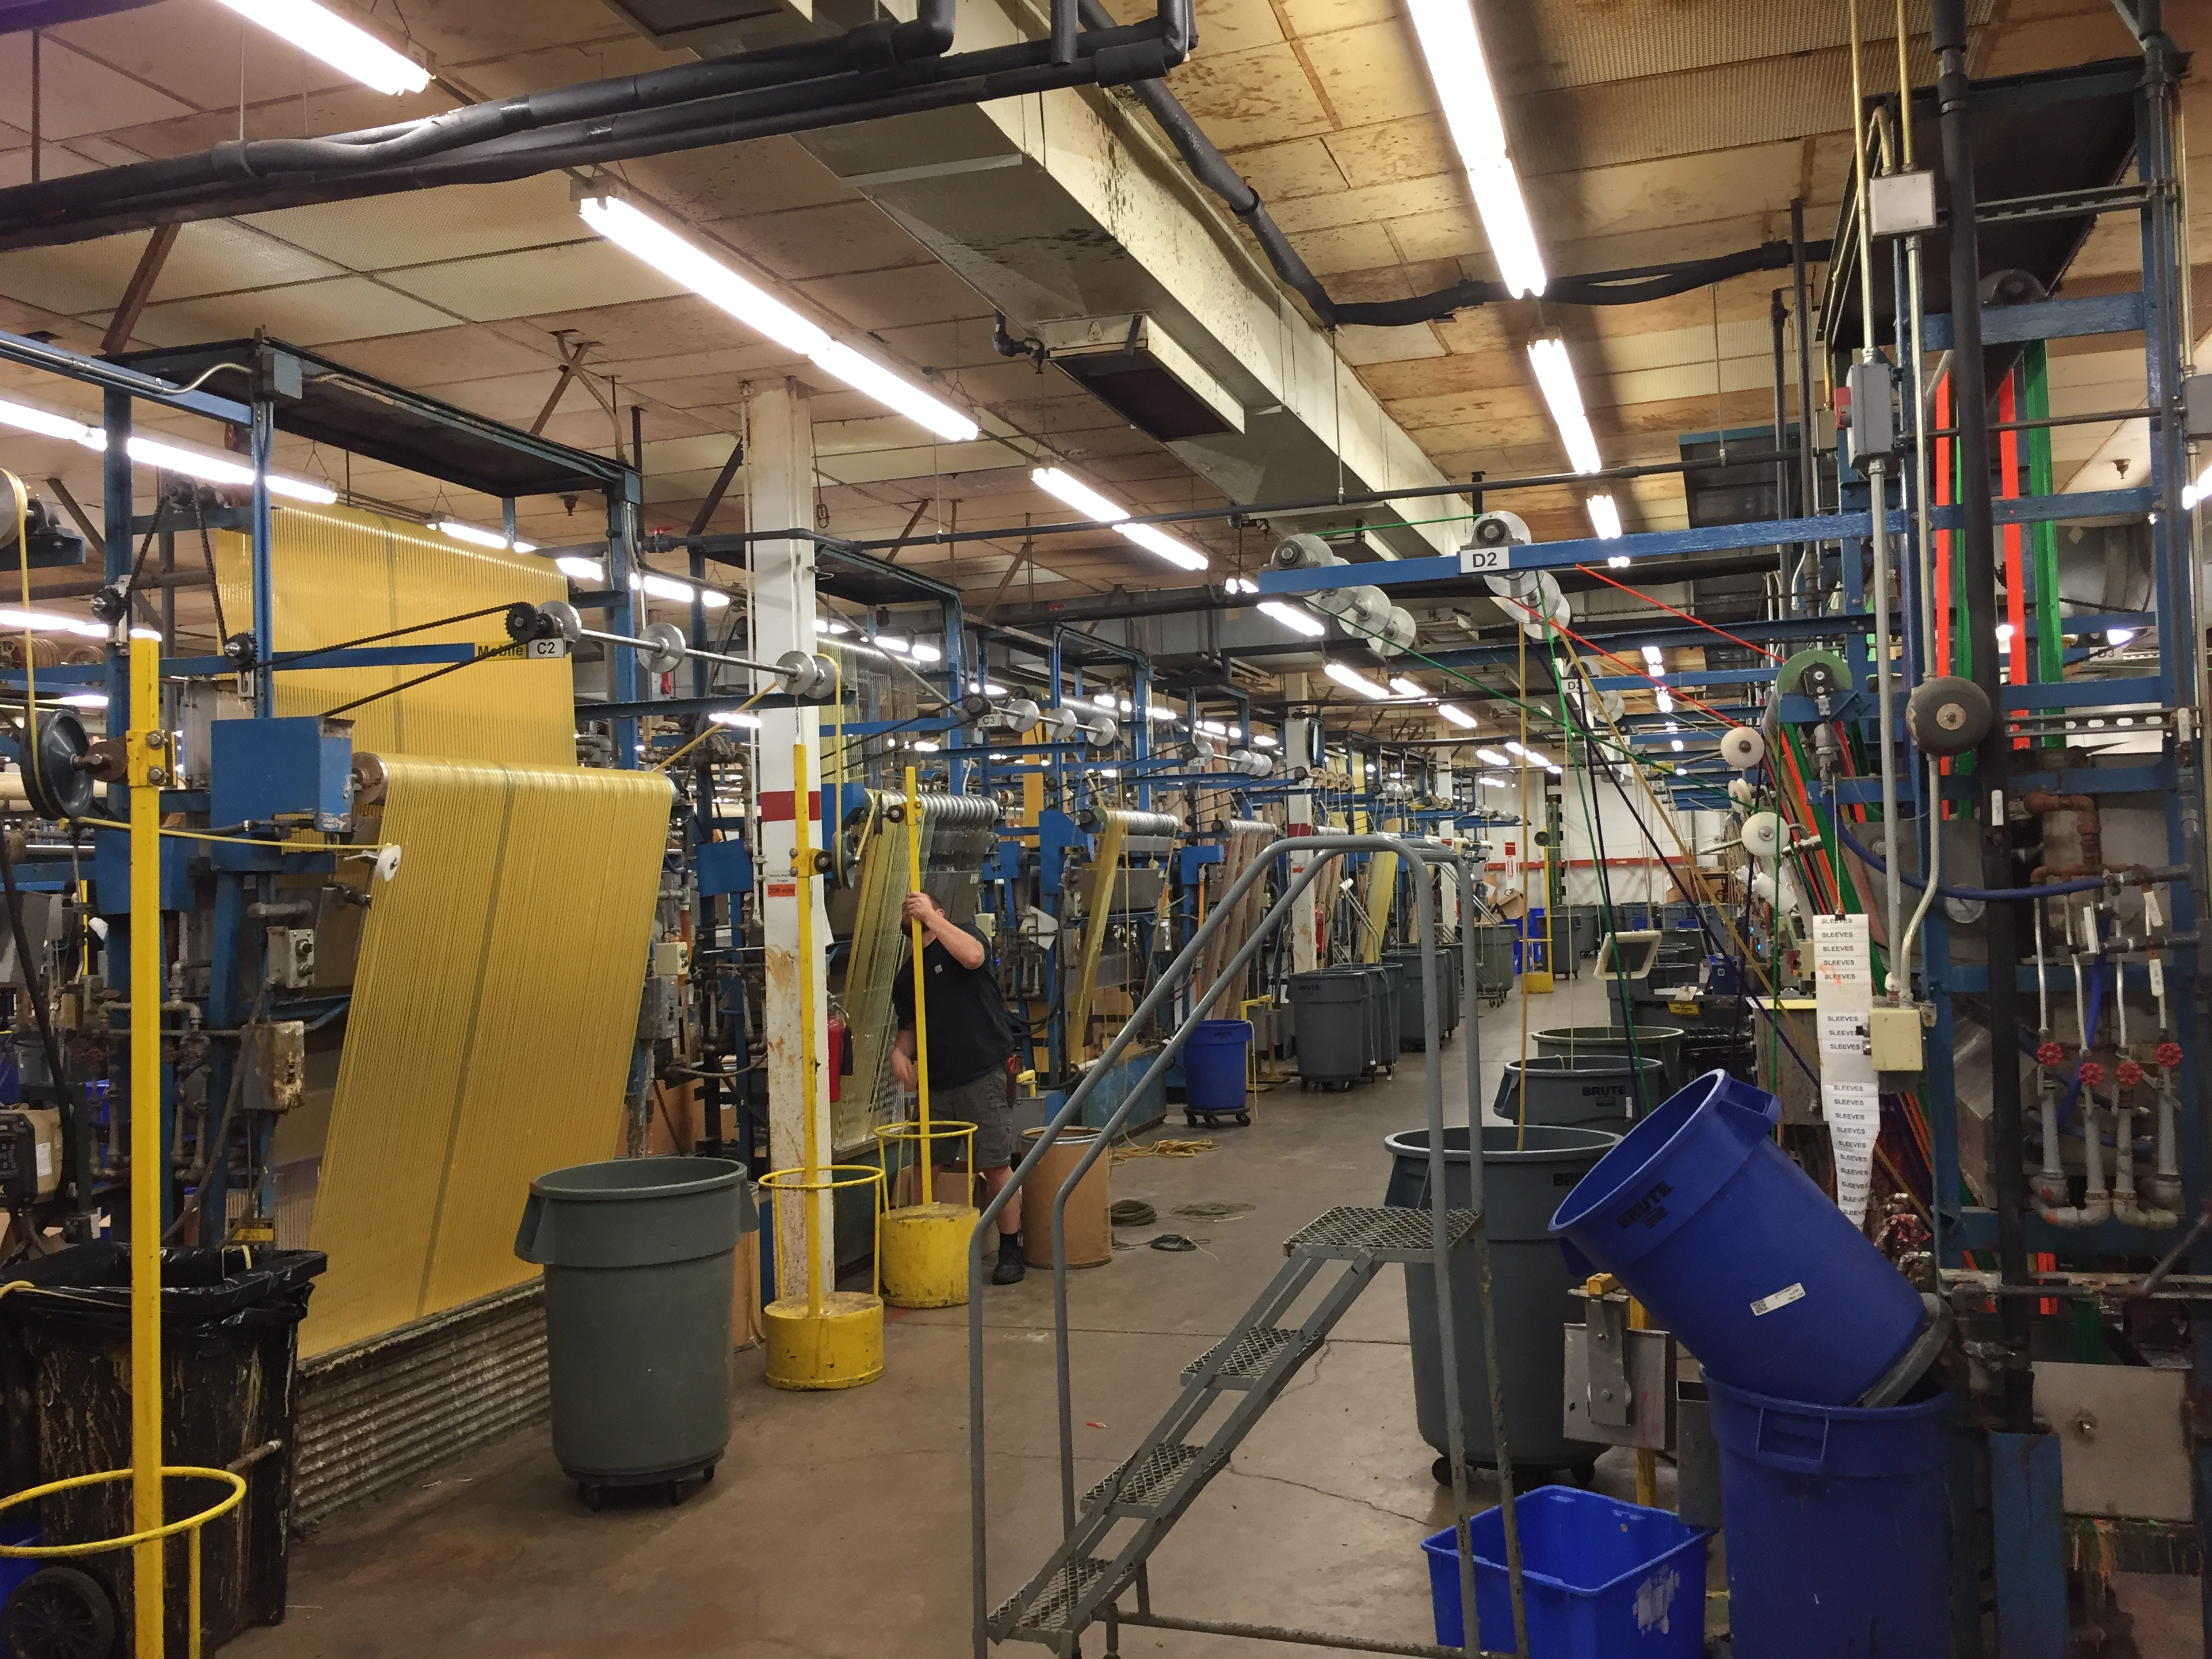
At Kent Elastomer Products, Inc.

Slide 10
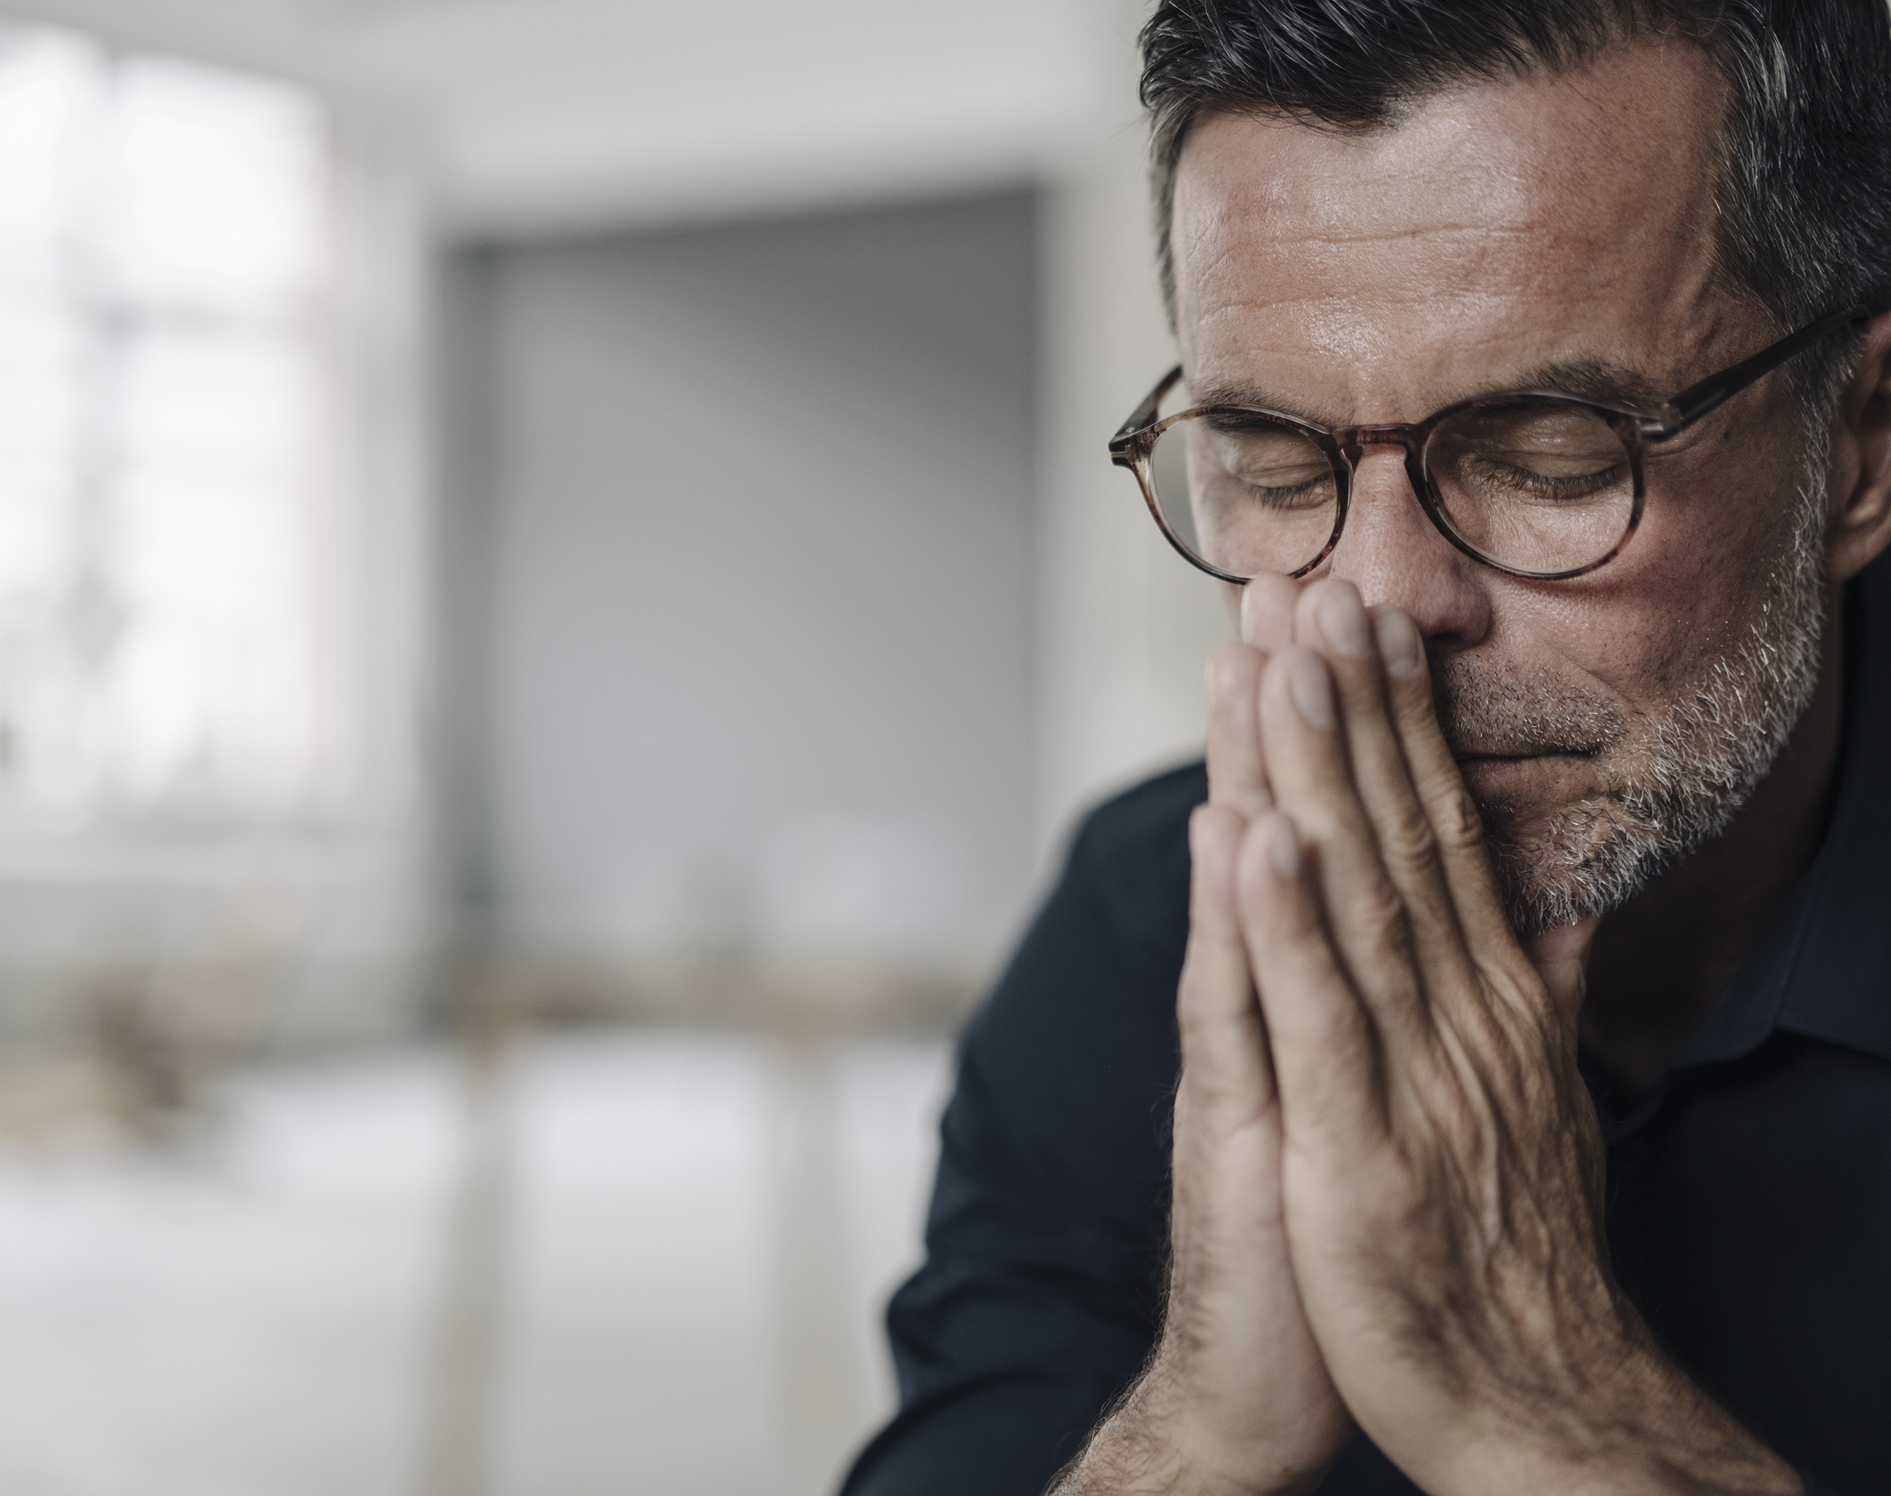
Bob was asked the question,
“How would you tell the family?”

Slide 11
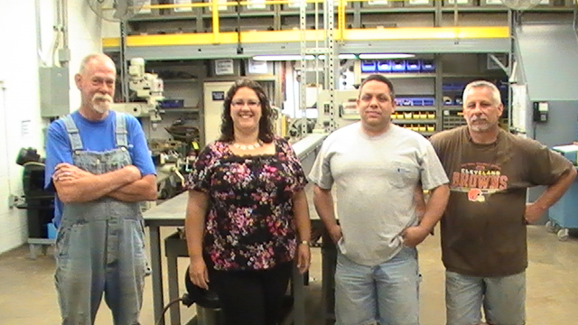
My reason why…

Slide 12
Make safety about the PEOPLE.
Safety costs money… accidents do too.
Culture –what does your safety culture really looks like?
KEY TAKEAWAYS
Key Takeaways

Slide 13
Same language
Negotiations
Listening for
Learned preferences
Communication

Slide 14
People need different amounts of information and time to process.
Learn how your company accounts for safety & talk in those terms.
Practice communicating to improve.
KEY TAKEAWAYS
Communication

Slide 15
The Thin Book of Trust: An Essential Primer for Building Trust at Work, By Charles Feltman
Care
Sincerity
Reliability
Competence
Trust

Slide 16
There are different kinds of trust.
Safety people typically focuses on competence.
Employees want to know you are sincere and you care about them.
Starting with small “wins” helps to build trust with Managers.
High trust = Fast company
KEY TAKEAWAYS
Trust

Slide 17
Bias
Information Bias
Recall Bias
Observer Bias
Research Bias
Cognitive Bias
Sampling Bias
Selection Bias
Andy
Bias & Complainers

Slide 18
There are lots of kinds of bias. Check your thoughts.
People tend to know something is unsafe even if they can’t communicate it well.
Sometimes, complainers can be a secret weapon for safety.
KEY TAKEAWAYS
Bias & Complainers

Slide 19
Hazard Level
Frequency
Stepped Improvement
Urgency
Effort
Cost/ Budget
Priority

Slide 20
Prioritize in different ways to get everything done that can be done right now.
Make a “Lose Sleep List”
It’s going to take time.
Safety (and leadership!) is a journey.
KEY TAKEAWAYS
Priority

Slide 21
BWC
Safety Council
Networking
Classes
Online
Coworkers
Fire Department
MCO/TPA
Do as much as we can with the resources we have.
Resources

Slide 22
Get creative – connect to as many resources as you can.
There are TONS of free resources.
Do as much as you can with the resources you have!
You don’t need to know it all… you need to know where to go to get it done.
KEY TAKEAWAYS
Resources

Slide 23
Core values are the deeply ingrained principles that guide all of a company's actions; they serve as its cultural cornerstones. Collins and Porras succinctly define core values as being inherent and sacrosanct (especially of a principle, place, or routine; regarded as too important or valuable to be interfered with); they can never be compromised, either for convenience or short-term economic gain.
Harvard Business Review
https://hbr.org/2002/07/make-your-values-mean-something
What is a
CORE VALUE?

Slide 24
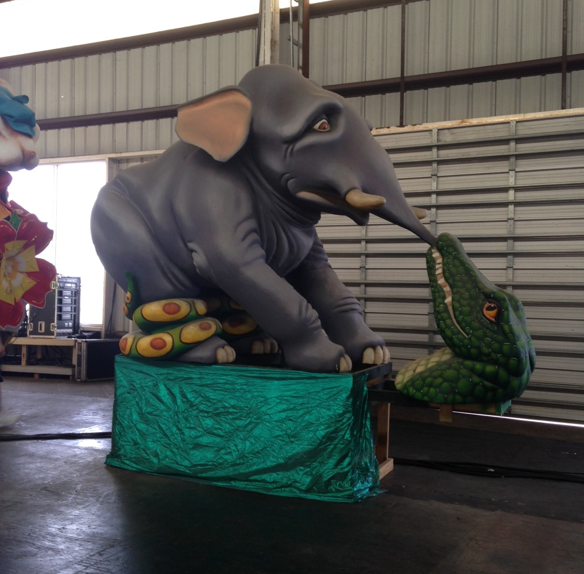
KEY TAKEAWAYS
How do you eat an elephant?

