Slide 1



Lockout/Tagout
Brian Zachetti, CSP
Industrial Safety Consultant Specialist
BWC Division of Safety & Hygiene
Notes:
1

Slide 4

Standard Implementation
Implemented in January 1990 -
In response to:
Caused Annually By Improper Shutdown of Machinery
122 | Fatalities
28,400 | Lost Workday Injuries
32,000 | Non-Lost Workday Injuries

Slide 5
Mahoning Valley Real Life Cases
Food Mixer
Screw Conveyer
Coil Slitter Exit End
Extrusion Mill

Slide 6
When Do I Lockout?
This standard applies to the control of energy during servicing and/or maintenance of machines and equipment.

Slide 7
What Is Servicing/Maintenance?
Constructing
Installing
Setting up
Adjusting
Modifying
Servicing
Tool changes
Machine lubrication
Part replacement

Slide 8
Normal Production 1910.147(a)(2)(ii)
This standard does not cover normal production operations. It covers servicing and/or maintenance, which takes place during normal production operations, if:
  An employee is required to remove or bypass a guard or other safety device;
  An employee is required to place any part of their body into the point of operation.

Slide 9
Minor Servicing Exemption
Exception to paragraph (a)(2)(ii): Minor tool changes and adjustments, and other minor servicing activities, which take place during normal production operations, are not covered by this standard if they are routine, repetitive and integral to the use of the equipment for production, provided that the work is performed using alternative measures which provide effective protection.

Slide 10
Lockout Vs. Minor Servicing Exemption
Lockout/tagout provides the greatest level of protection and, whenever possible, should be used to protect employees from hazardous energy.
  UAW view
  Abuse Of minor servicing exemption
  Identify tasks in your facility
  Risk assessment

Slide 11
Three Criteria for Minor Servicing Exemption
You can use three specific criteria to determine if the minor servicing exception would apply to a particular activity.
First, the activity must be conducted during normal production operations, i.e., while the machine or equipment is actually performing its intended production function.

Slide 12
Three Criteria for Minor Servicing Exemption
Second, the activity must be:
Routine: The activity must be a regular course of procedure and be in accordance with established practices;
Repetitive: The activity must be regularly repeated as part of the production process;
Integral: The activity must be essential to the production process.

Slide 13
3 Criteria For Minor Servicing Exemption
Third, if all of these apply:
The employer must use alternative measures to provide effective protection from the hazardous energy;
These alternative measures must enable the employee to safely perform the servicing task without being exposed to the unexpected energization or activation of the equipment, or the release of stored energy.

Slide 14
Minor Servicing Questions
Is the task short in duration?
Does the task occur frequently during the shift?
Is the task usually performed by operators, setup, service?
Does the task involve extensive disassembly?
Does the task represent predetermined cyclical activities?

Slide 15
Minor Servicing Questions
Is the task expected to occur regularly?
Does the task minimally interrupt part of the production process?
Does the task exist even when optimal operating levels are achieved?
Does traditional lockout/tagout prohibit the completion of the task?

Slide 16
LOCKOUT
The process of blocking the flow of energy from a source to a piece of equipment and keeping it blocked.

Slide 17
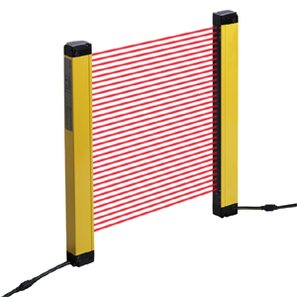
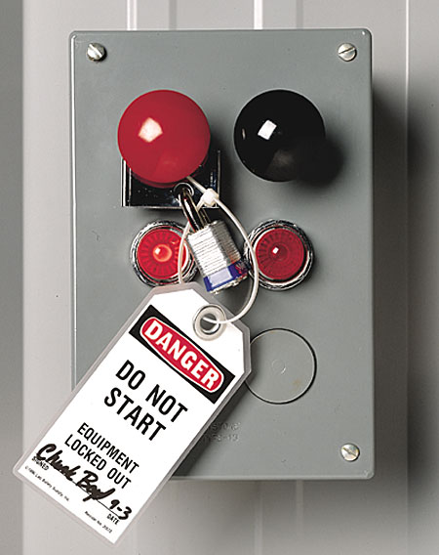
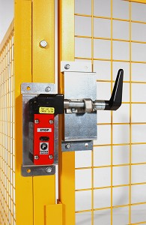
Can I Use These As A Lockout Method?

Slide 18
Energy Isolation Device
A mechanical device that physically prevents the transmission or release of energy, including but not limited to the following: A manually operated electrical circuit breaker; a disconnect switch; a line valve; a block; and any similar device used to block or isolate energy. Push buttons, selector switches and other control circuit type devices are not energy isolating devices.

Slide 19
Improper Lockout Procedures

Slide 20
Why You Can’t Just Lock Out the Push Button or Switch
Another employee enters the motor controller (motor starter) enclosure and manually closes the relay.
The push button malfunctions.
There is a failure rate of a relay or motor controller (e.g., defective spring; welded contacts).

Slide 21
Why You Can’t Just Lock Out the Push Button (continued)
A machine jam occurs causing higher current in the motor circuit, resulting in the freeze-up of the controller relay contact parts because the current creates arcing, which in turn welds shut the relay‘s plunger-coil mechanism.

Slide 22
Why You Can’t Just Lock Out the Push Button (continued)
A loose wire contacts the conduit or enclosure.
Two wires short out inside a damaged conduit (e.g., vibration causes wires to rub and wear through the wire’s insulation resulting in an electric short and bridging of the control circuit).
Water, dirt, metal particles or other conductive foreign debris enters the control circuit enclosure causing the switch to operate because the material sufficiently bridges and closes the circuit, allowing current flow.

Slide 23
TAGOUT
A warning not to restore energy. It is not a physical restraint but has the same effect as a lock does.

Slide 24
List & Identify all Sources Of Energy
Electrical
Hydraulic
Pneumatic
Thermal
Chemical
Mechanical
Cord & Plug Equip.
Other Types
Notes:
3

Slide 25
Procedures For Each Piece Of Equipment
Written procedures must be documented for each piece of equipment.
If machinery or pieces of equipment are similar, just one procedure will cover all like pieces.
Notes:
4

Slide 26
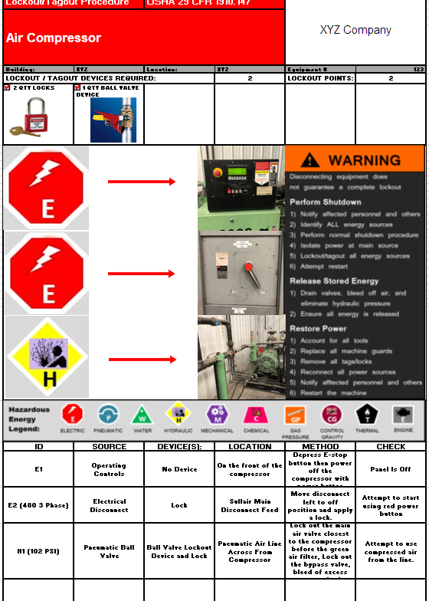
Procedures For Each Piece Of Equipment
Notes:
Let Brain share screen and talk about his form

Slide 27
Safe Procedures for Energy Control Program
1910.147(c)(1)
Employer shall establish a program consisting of:
Steps for Shutting down all energy sources.
Steps for all potentially hazardous stored or residual energy to be relieved, otherwise rendered safe.
Steps for Placement, Removal & Transfer Of LO/TO Devices.
Steps for testing to verify LO/TO.
Training & Enforcement Policy.
Notes:
5

Slide 28
VERIFICATION OF ISOLATION
1910.147(d)(6)
Prior to starting work on equipment that have been locked/tagged out, the authorized employee shall verify that isolation and de-energization of the machine or equipment have been accomplished.

Slide 29
Identify Different Personnel
Authorized
Affected
Other
Notes:
6

Slide 30
RESPONSIBILITIES OF AUTHORIZED
Have sufficient number of locks with lock identification, tags and keys to fully isolate all energy sources during maintenance or service of a machine or equipment.
Properly apply these energy isolating devices, lock(s) and tag(s).
Assure that all key(s) related to LOTO are properly controlled so that the locks cannot be removed without your knowledge.
Understand and follow the procedures or the LOTO program.
Be Responsible for following LOTO procedures that have been developed for specific equipment or machinery maintenance operations in your workspace.

Slide 31
RESPONSIBILITIES OF AFFECTED AND OTHER
Understand the purpose and importance of the LOTO program.
Recognize when the LOTO procedure is being implemented in your facility.
Make certain not to attempt startup of use of equipment that has been locked or tagged out.
SIMPLY: Whenever there is a LOTO device in place on an energy isolating device, leave it alone and do not attempt to operate the equipment.

Slide 32

LOCKOUT DEVICES
1910.147 (c)(5)
The employer shall provide locks, tags, chains, wedges, key blocks, adapter pins, self-locking fasteners, or other hardware
Lockout/tagout devices shall be:
  a) Identifiable e) Standardized
  b) Durable f) Substantial
  c) The only device used for controlling energy
  d) Not be used for other purposes

Slide 33
PROTECTIVE MATERIALS & HARDWARE
1910.147 (c)(5)
Durable
Capable of withstanding the environment for the maximum period of time
Tagout devices constructed and printed to withstand wet/damp locations
Tags shall not deteriorate when used in corrosive environments (acid and alkali chemicals)
Standardized
Lockout/tagout devices shall be standardized by:
  a) Color
  b) Shape
  c) Size
  d) Print and format (tagout devices)

Slide 34
PROTECTIVE MATERIALS & HARDWARE
1910.147 (c)(5)
Substantial
Lockout devices - prevent removal without use of excessive force (bolt cutters)
Tagout devices - prevent inadvertent or accidental removal.
Identifiable
Lockout/tagout devices indicate the identify of the employee applying the device(s).

Slide 35
PROTECTIVE MATERIALS & HARDWARE
1910.147 (c)(5)
Tagout attachment:
a) non-reusable b) attachable by hand
c) self-locking d) non-releasable
e) unlocking strength > 50 pounds
** equivalent to an all environment- tolerant nylon cable tie
Tagout devices include a legend such as the following: Do Not Start. Do Not Open. Do Not Close. Do Not Energize. Do Not Operate.

Slide 36


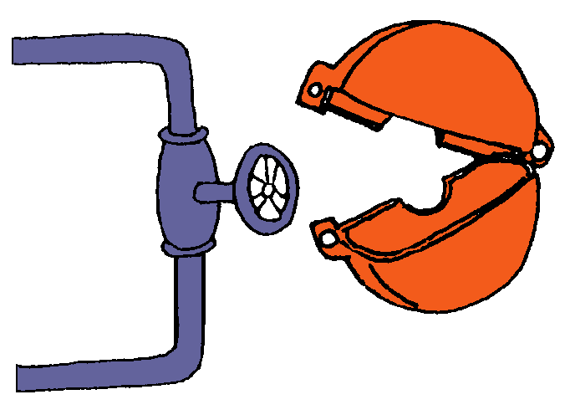
Training Of Authorized Employees
Types of Energy.
Magnitude Of Energy Sources
Locations & How to Lockout Energy Sources.
Types of Devices to Be Used.
Notes:
8

Slide 37
Training Affected & Other Employees
Purpose Of The Energy Control Program.
Types & How to Identify Lockout Devices.
To Understand That They Should Not Tamper With Any Devices Used In Lockout/Tagout Procedures.
Notes:
9

Slide 38
SHIFT OR PERSONNEL CHANGES
1910.147(f)(4)
Specific procedures for shift or personnel changes including provision for the orderly transfer of lockout or tagout device protection between off-going and oncoming employees, to minimize exposure to hazards from the unexpected energization or start-up of the machine or equipment, or the release of stored energy.

Slide 39
Develop Procedures on how you will Communicate with Contractors on LO/TO.
Who
What
When
Where
How
Notes:
11

Slide 40
Miscellaneous Items in Your Program
Procedures for removal of a lock when that person is not present.
Notifying affected employees when locks are to be applied or removed.
Notes:
12

Slide 41
Group Lockout Procedures.
Procedures on how you will handle more than one individual working on the same piece of equipment.
Notes:
13

Slide 42
Annual Inspection of Your Procedures
Date of Inspection.
Machine or Process to review Identified.
Names of persons involved in LO/TO.
Name of person doing Inspection.
Copy of Inspection kept on record.
Notes:
14

